Slide 1
Differential Low-Power PLL in 45-nm STSCL
By Victor Abarca and Raghav Kumar

Slide 2
Table of contents
INTRODUCTION & MOTIVATION
WHAT IS SUBTHRESHOLD?
WHAT IS SOURCE COUPLED LOGIC?
TYPICAL PLL OPERATION
PHASE FREQUENCY DETECTOR
CHARGE PUMP
VCO
LOOP FILTER
DIVIDER
SYSTEM OVERVIEW
RESULTS
CONCLUSION & FUTURE WORK
REFERENCES

Slide 3
Introduction & motivation
Phase-Locked Loops (PLL) are control systems with a wide variety of applications in RF and clock-data recovery
PLLs tend to be power consumptive due to high transistor density and difficult operations
Low-power PLLs are attractive choice as transistor sizes become smaller

Slide 4
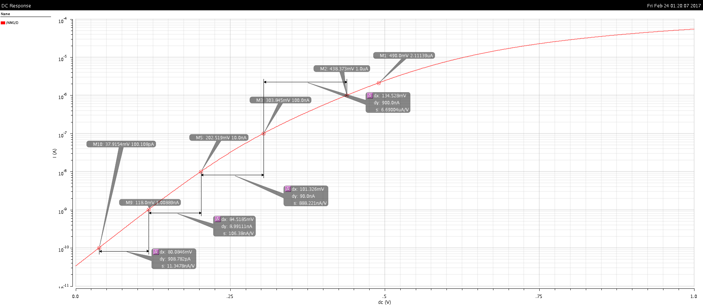
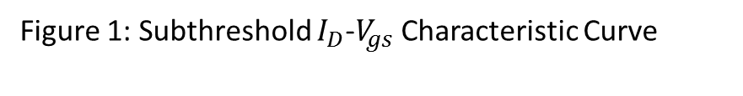
What is Subthreshold?
Occurs due to MOSFET non-idealities during cut-off
Makes use of leakage current in MOSFETs
Very advantageous in low-power applications
Subthreshold Swing – important parameter
Figure 1: Subthreshold $I_{D}$-$V_{gs}$ Characteristic Curve

Slide 5
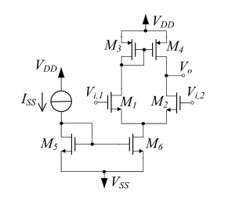
Source coupled logic
A type of current steered logic centered around the differential pair
Gets name from transistor source terminals tied together
Commonly used in low-power applications
Figure 2: Conventional Actively-loaded Differential Pair

Slide 6
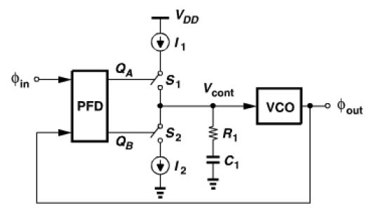
Typical PLL operation
PFD comapres reference and output; produces phase error
CP takes phase error and converts this to a current
LF gets charged/discharged by CP, changing control voltage
Control voltage to VCO creates waveform of proportional output frequency
Figure 3: Typical PLL system diagram

Slide 7
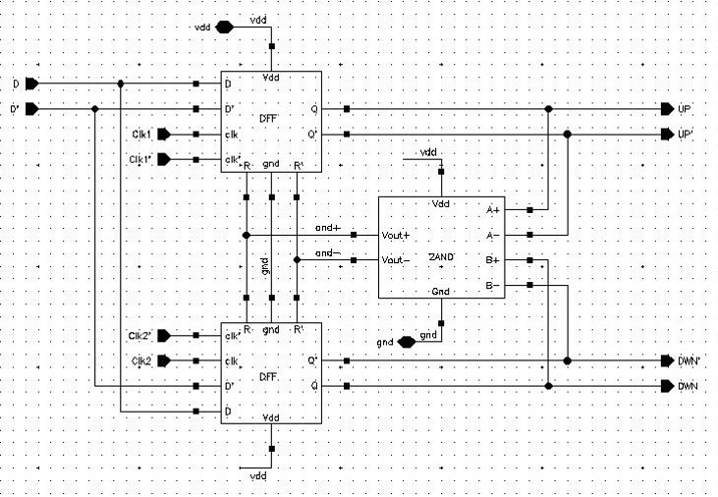
PHASE FREQUENCY DETECTOR
PFD compares reference and output, creating a phase error
STSCL PFD is fully differential
Average power consumption: 6.2 µW at 150 MHz reference
Figure 4: STSCL-based PFD

Slide 8
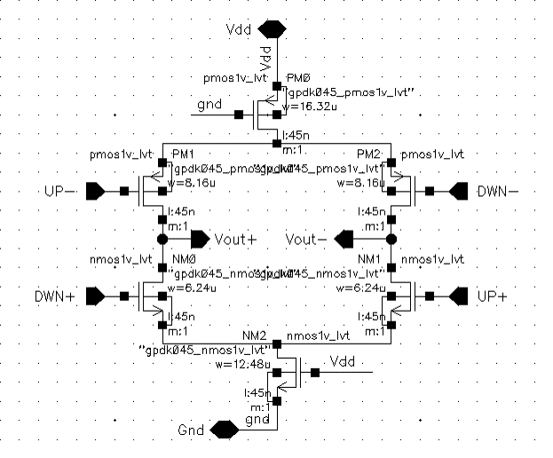
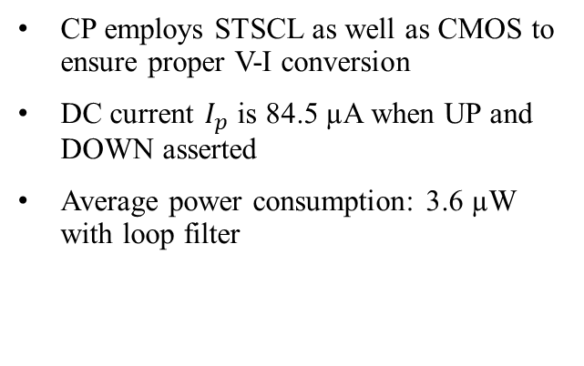
Charge pump
CP employs STSCL as well as CMOS to ensure proper V-I conversion
DC current $I_{p}$ is 84.5 µA when UP and DOWN asserted
Average power consumption: 3.6 µW with loop filter
Figure 5: STSCL-based CP

Slide 9
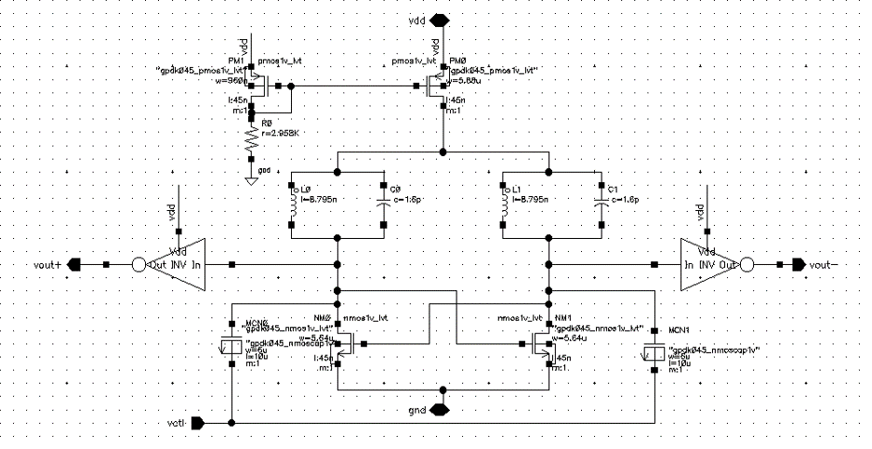
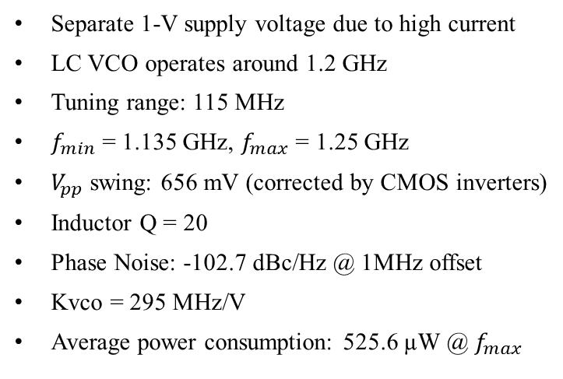
LC VCO
Separate 1-V supply voltage due to high current
LC VCO operates around 1.2 GHz
Tuning range: 115 MHz
$f_{min}$ = 1.135 GHz, $f_{max}$ = 1.25 GHz
$V_{pp}$ swing: 656 mV (corrected by CMOS inverters)
Inductor Q = 20
Phase Noise: -102.7 dBc/Hz @ 1MHz offset
Kvco = 295 MHz/V
Average power consumption: 525.6 µW @ $f_{max}$
Figure 6: LC VCO with top current source

Slide 10
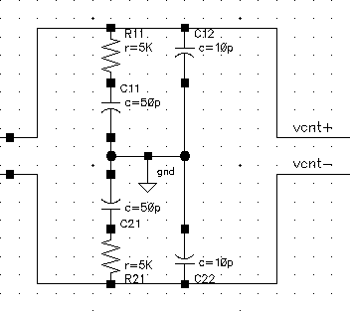
Loop filter
Loop Filter provides two poles for C1 and C2 and one zero for R1
Two loop filters were used: one for each control line
R1 = 5 kΩ, C1 = 50 pF, C2 = 10 pF
Phase margin = 90 °
Figure 7: Loop Filters on control lines

Slide 11
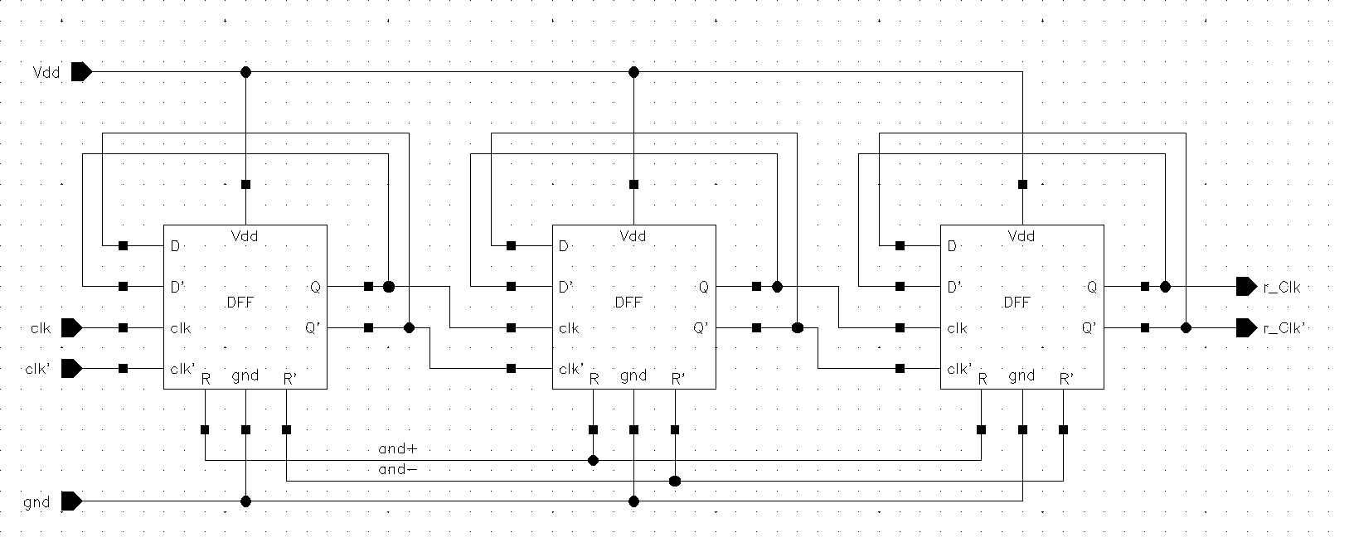
Frequency divider
Performs a divide by 8 operation
Takes in 1.2 GHz and outputs 150 MHz
Consists of three DFFs, all in STSCL
Average power consumption: 8.5 µW
Figure 8: Frequency divider with 3 STSCL DFFs

Slide 12
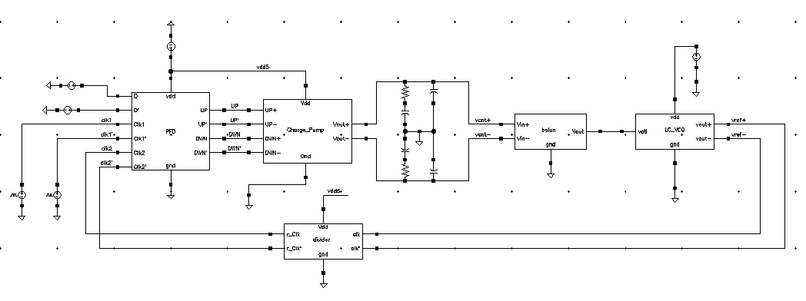
System overview
Specifications | Value
Supply Voltage | 500 mV and 1 V (only for VCO)
Order | 3
Type | 2
Phase Margin | 89°
Lock Time | ~ 900 ns
Average Power Consumption | 371.7 uW
Reference frequency | 150 MHz
Output frequency | 1.2 GHz
Phase Noise | -102.7 dBc/Hz @ 1 MHz offset
Figure 9: Overall System Schematic

Slide 13
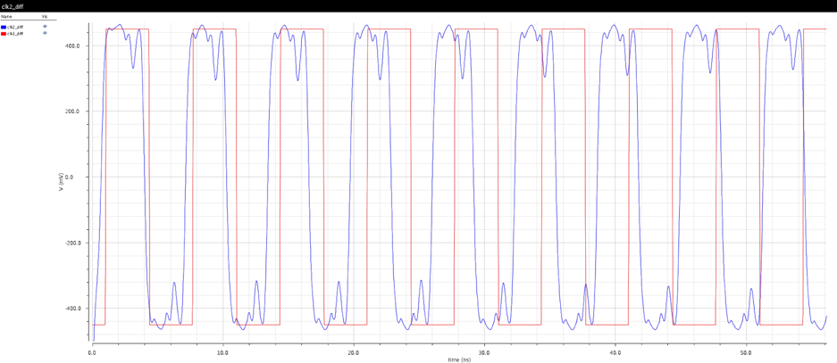
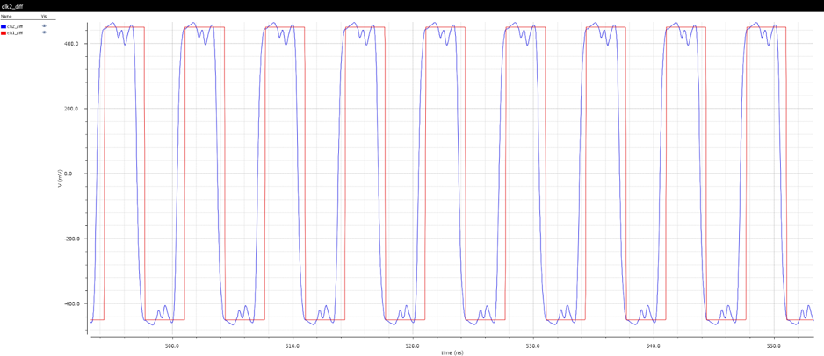
RESULTS
Figure 10: PLL output from 0 to 50 ns
Figure 11: PLL output from 500 ns to 600 ns

Slide 14
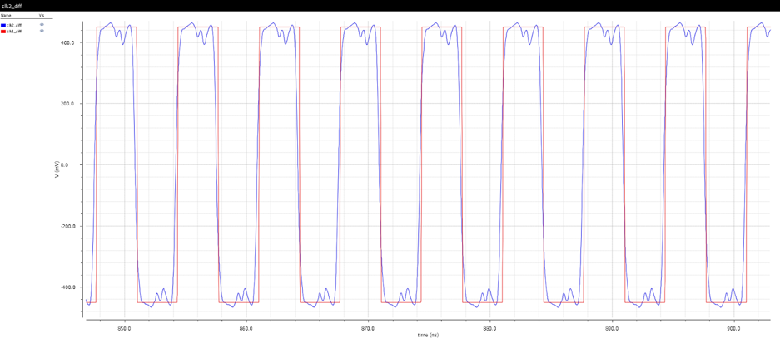
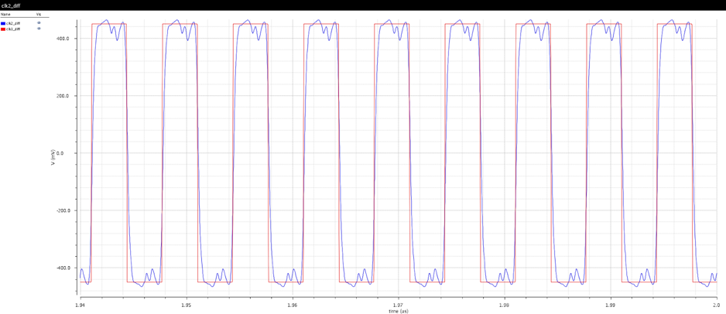
RESULTS (Contd)
Figure 12: PLL output from 850 ns to 900 ns (approx. lock time)
Figure 13: PLL output from 1.94 µs to 2 µs

Slide 15
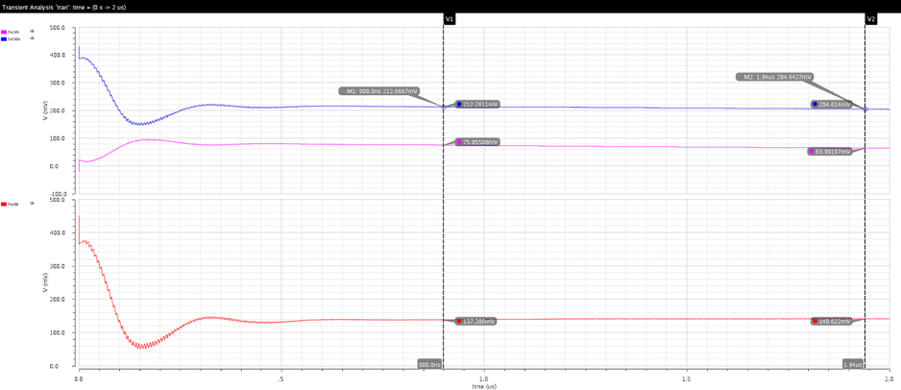
RESULTS (Contd)
Figure 14: PLL control voltage stabilization

Slide 16
Conclusion & Future work
STSCL PLL successfully locks at reference frequency of 150 MHz, while output is 1.2 GHz
Average power consumption during operation = 372 µW
PFD, CP, LF, VCO and DIVIDER circuits described
Overall PLL system characterized
Future Work: test operation for wider range of frequencies; layout

Slide 17
REFERENCES
[1] B. Razavi, RF Microelectronics, 2nd ed. New York: Paul Boger, 2011, pp. 497-652.
[2]"Control Tutorials for MATLAB and Simulink - Extras: Steady-State Error", Ctms.engin.umich.edu, 2017. [Online]. Available: http://ctms.engin.umich.edu/CTMS/index.php?aux=Extras_Ess. [Accessed: 08- May- 2017].
[3]D. Collins, "A Fully Differential Phase-Locked Loop With Reduced Loop Bandwidth Variation", Masters Thesis, National University of Ireland, Maynooth, 2011.
[4]"Beginners Guide To Clock Data Recovery", PDA, 2017. [Online]. Available: https://protocol-debug.com/2017/02/01/beginners-guide-to-clock-data-recovery/. [Accessed: 08- May- 2017].
[5]S. IKEDA, S. LEE, T. KAMIMURA, H. ITO, N. ISHIHARA and K. MASU, "A Sub-1mW Class-C-VCO-Based Low Voltage PLL with Ultra-Low-Power Digitally-Calibrated ILFD in 65nm CMOS", IEICE Transactions on Electronics, vol. 97, no. 6, pp. 495-504, 2014.
[6]S. Kim, J. Rhim, D. Kwon, M. Kim and W. Choi, "A low-voltage PLL with a current mismatch compensated charge pump", in SoC Design Conference (ISOCC), 2015 International, Gyungju, South Korea, 2015, pp. 15-16.
[7]S. Kim, J. Rhim, D. Kwon, M. Kim and W. Choi, "A Low-Voltage PLL With a Supply-Noise Compensated Feedforward Ring VCO", IEEE Transactions on Circuits and Systems II: Express Briefs, vol. 63, no. 6, pp. 548-552, 2016.
[8]D. Walkey, "MOSFET Operation", Carleton University, Ottawa, Canada.
[9]H. Kanitkar, "Subthreshold circuits: Design, implementation and application", Masters of Science, Rochester Institute of Technology, 2009.
[10]M. Wu, "Discussion #9: MOSFETs", University of California at Berkeley, California, 2008.
[11]Grasso, Alfio Dario et al. "0.9-V Class-AB Miller OTA In 0.35-Μm CMOS With Threshold-Lowered Non-Tailed Differential Pair". IEEE Transactions on Circuits and Systems I: Regular Papers (2017): 1-8. Web.

